Slide 1
Background PA-MLT Dependence

Slide 2
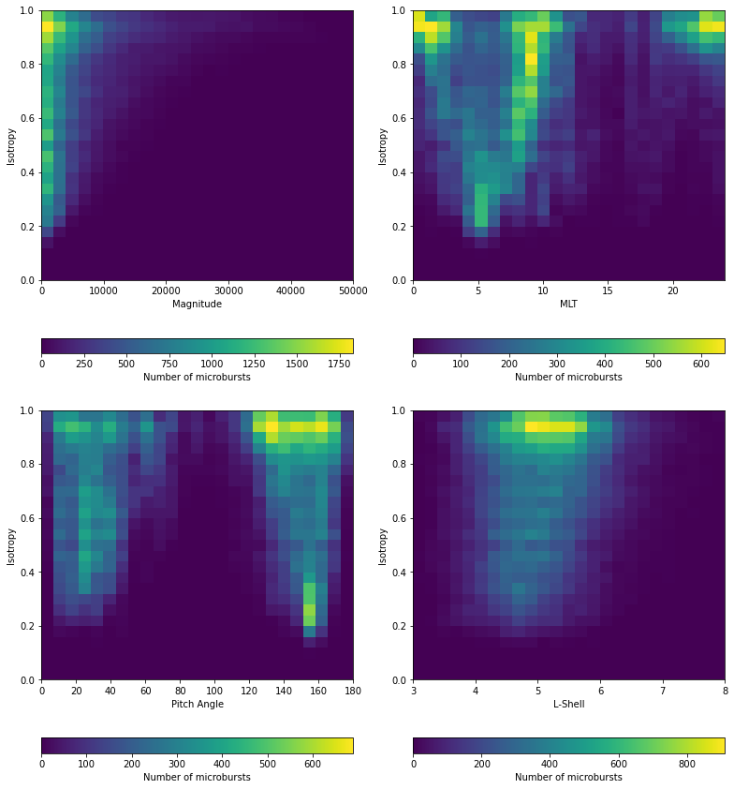
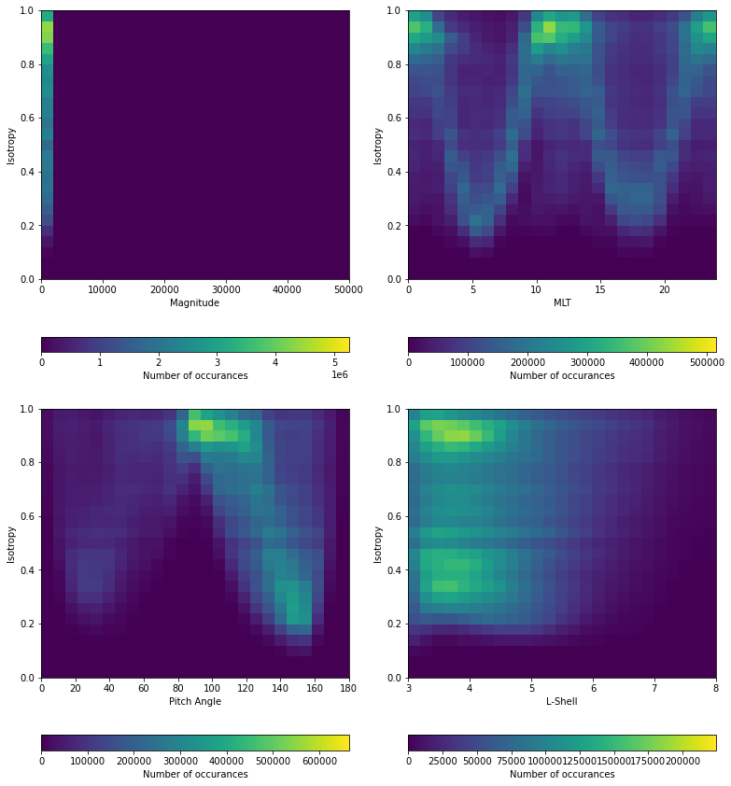
Isotropy-MLT Pattern in Data

Slide 3

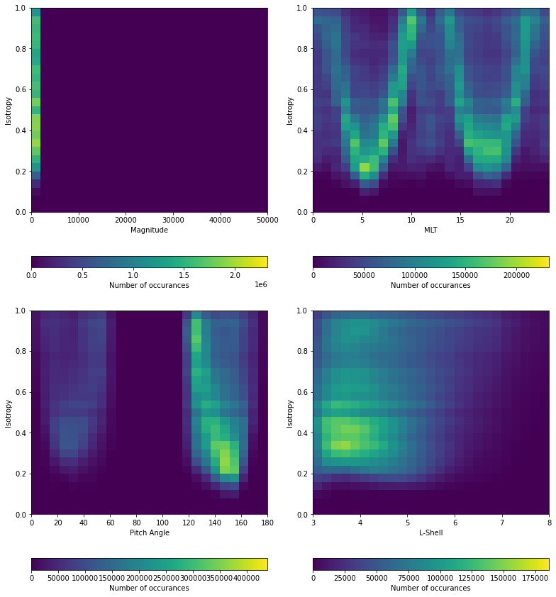
Full histograms masked at PA mag <= 60

Slide 4
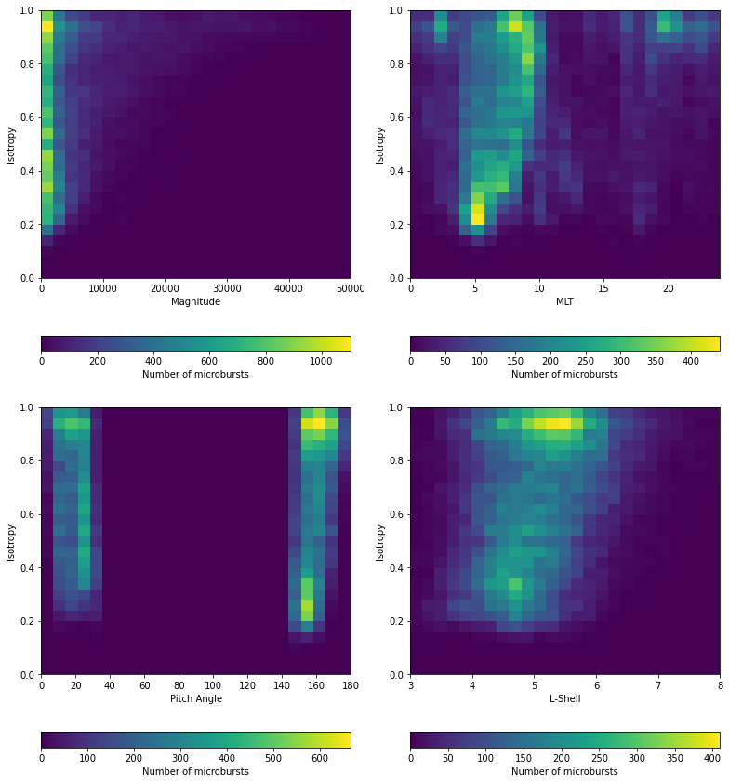
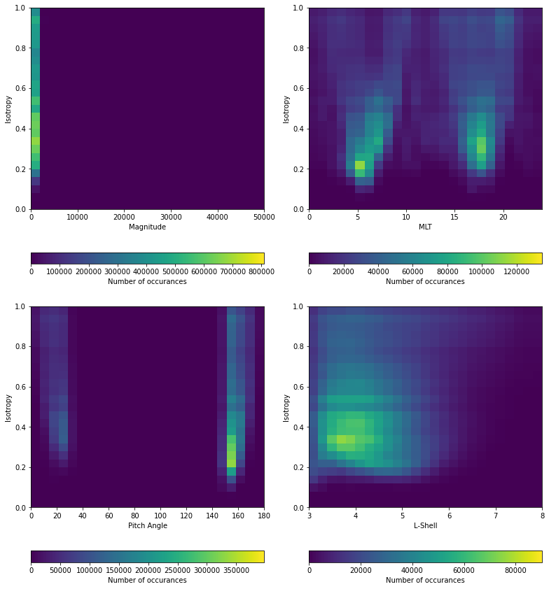
Full histograms masked at PA mag <= 30

Slide 5
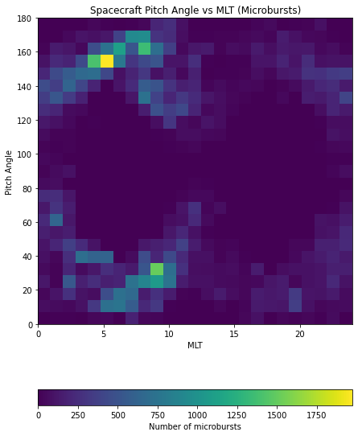
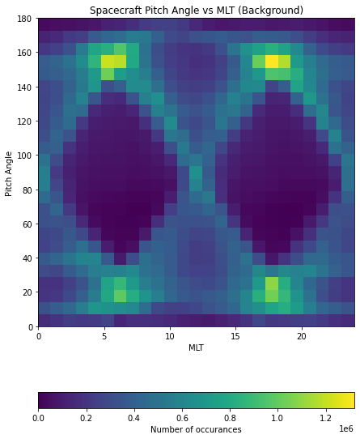
New Finding: Spacecraft PA-MLT Dependence

Slide 6
Conclusions:
The working pitch angle isotropy calculation (SSD1, SSD4 ratio) only works for asymmetric spacecraft pitch angles (not 0, 90, or 180)
The pattern in the Isotropy vs MLT seen in Slide 2 is a result of the PA-MLT dependence of the spacecraft caused by the spacecraft changing pitch angle throughout the orbit
Any more thoughts? Is masking PA_mag <= 30 best?
Add masks: latitude mask for SAA, L-Shell mask? (3-8)

